Slide 1
Classification using LSTM Recurrent Neural Network
Group 11

Slide 2
Background
FYP project
Automatic taxonomy generation for lower resources setting.
Two approaches
Pattern-based
Distributed
Selected scope
Improving pattern-based approach

Slide 3
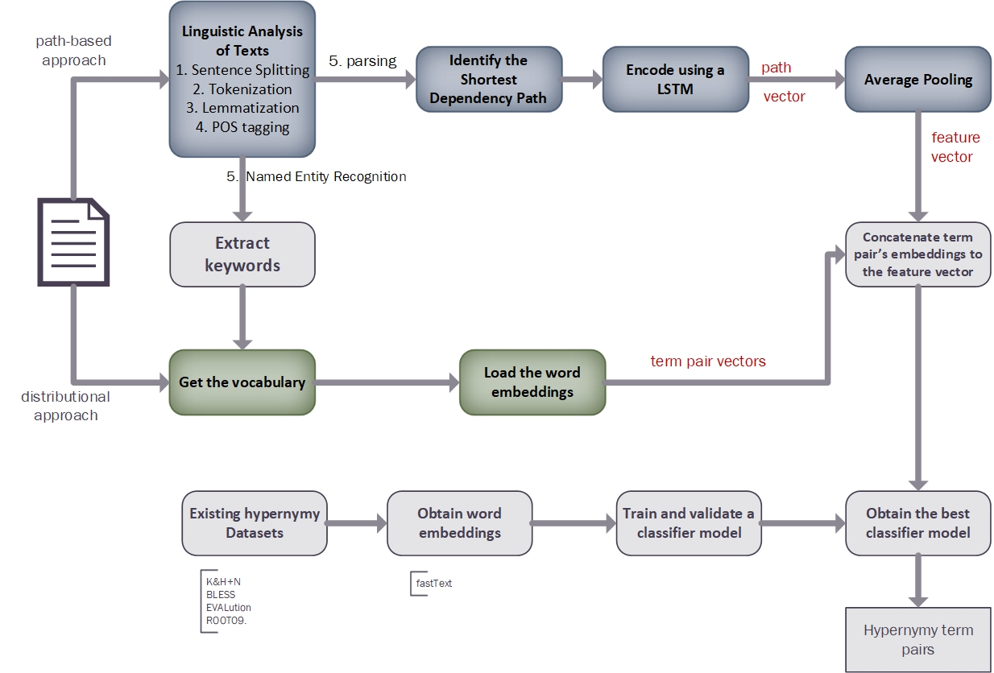
Methodology - Automatic taxonomy construction

Slide 4
Problem & Motivation
How to improve hypernym detection path-based approach by using machine learning ?
Existing pattern based approaches for hypernym detection show low performance.
Eg: Hearst pattern, Substring inclusion

Slide 5
Improving path-based approach
Path representation, using a recurrent neural network.
Split the dependency path to edges.
Let the network learn a vector representation of the entire path, by going over the edges sequentially.
Use the above vectors as input of LSTM classifier.

Slide 6
Why Recurrent Neural Network?
To classify word list into
hyper
mero
random ...
Why use RNN?
RNN able to connect previous information to the present task.
Eg: “the clouds are in the ………..” → sky

Slide 7
Why Long Short Term Memory RNN
As that gap grows, RNNs become unable to learn to connect the information.
Eg: “ I grew up in France. I speak fluent ……. “ → French
LSTMs are explicitly designed to avoid the long-term dependency problem.
Learning long-term dependencies in recurrent networks using gradient descent is a very difficult task.

Slide 8
Approach
Dataset - BLESS
Contains a set of tuples with explicitly typed semantic relations, plus a number of controlled random tuples.
Create a neural network with two layers.
By using dyNet

Slide 9
Improve the Results
Word dropout rate
To reduce overfitting
lexical memorization
Lexical split - split the train and test sets such that each will contain a distinct vocabulary.

Slide 10
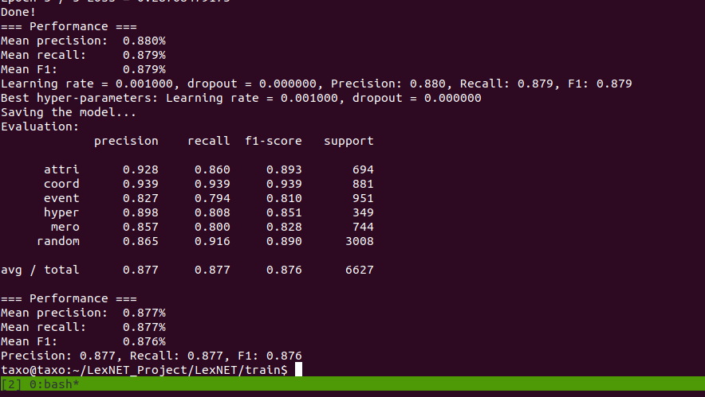
Analysis of Results
Analysis of Results

Slide 11
Thank You

